Slide 1

Accidents Analysis & Prediction
Group 4
2019.6.13

Slide 2
Introduction
From the invention of various types of transportation, the convenience of transportation is accompanied by certain dangers.
Our training focuses on statistics, analysis and prediction of traffic accidents. We hope to get some information from the existing data to help our transportation department make better decisions.
Machine learning is the core technology we use. We mainly use PCA, LDA, t-SNE, Decision Tree, SVR and other algorithms to reduce, cluster and analyze data, using Python as the main language, using Common Python tools such as Pandas, sklearn and matplotlib to help us code.
A variety of rich visualization technologies can visualize abstract figures. On the one hand, we can make the machine learning technology we use more understandable, and on the other hand, the traffic supervision department can better understand the meaning behind the data. We used tools such as Echarts and the Google Maps API to codea series of interactive visualizations based on HTML, CSS, and JavaScript.
We also designed and produced a website that simulates the actual usage scenarios of the traffic department and implements a complete interactive process, including exciting features such as existing data analysis, real-time predictive analysis of data uploads.

Slide 3
Initialization

Slide 4
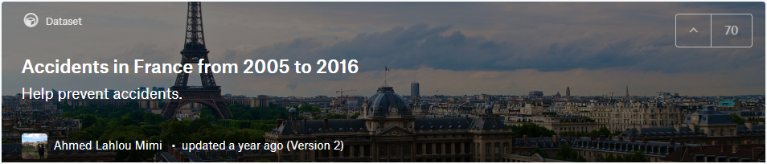
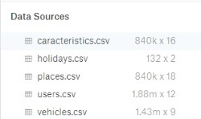
Choosed the data
6,000
The dataset selected by our group is “accidents-in-france-from-2005-to-2016”
In the dataset, there are 5 csv files, which are caracteristics.csv, places.csv, users.csv, holidays.csv and vehicles.csv
Notes:
These files detail the properties, accident locations, personnel and vehicles of every traffic accident that occurred in France between 2005 and 2016.
What we want to do is to use machine learning to predict the likelihood of future traffic accidents and the number of deaths in traffic accidents that have occurred by processing the data set. In addition, we will visualize existing data to analyze the impact of different factors on traffic accidents. Our team is ready to create a web-based app based on the above ideas.

Slide 5
Choosed the data
6,000
Predict the number of deaths in traffic accidents.
Predict the likelihood of future traffic accidents.
Visualization data.
Notes:
These files detail the properties, accident locations, personnel and vehicles of every traffic accident that occurred in France between 2005 and 2016.
What we want to do is to use machine learning to predict the likelihood of future traffic accidents and the number of deaths in traffic accidents that have occurred by processing the data set. In addition, we will visualize existing data to analyze the impact of different factors on traffic accidents. Our team is ready to create a web-based app based on the above ideas.

Slide 6
Use Case Diagram

Slide 7
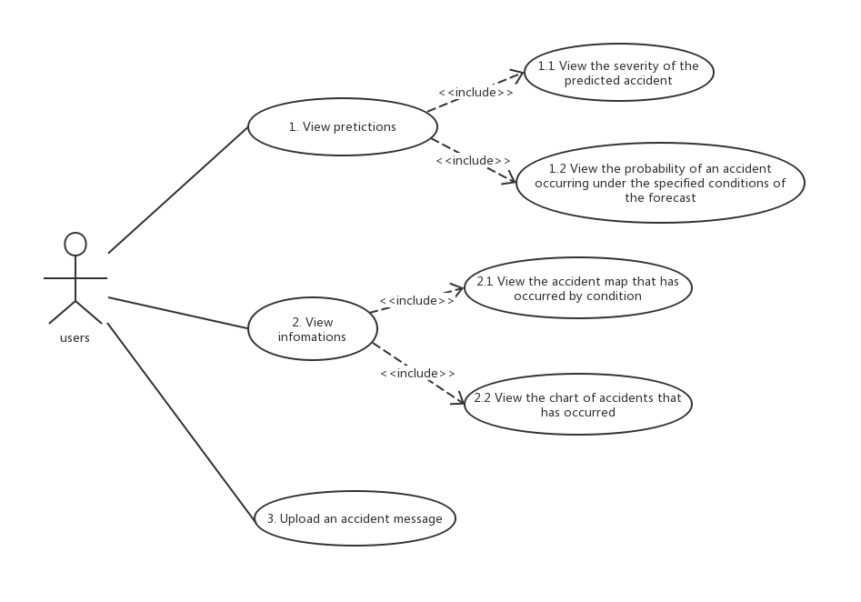

Slide 8
Class Diagram

Slide 9
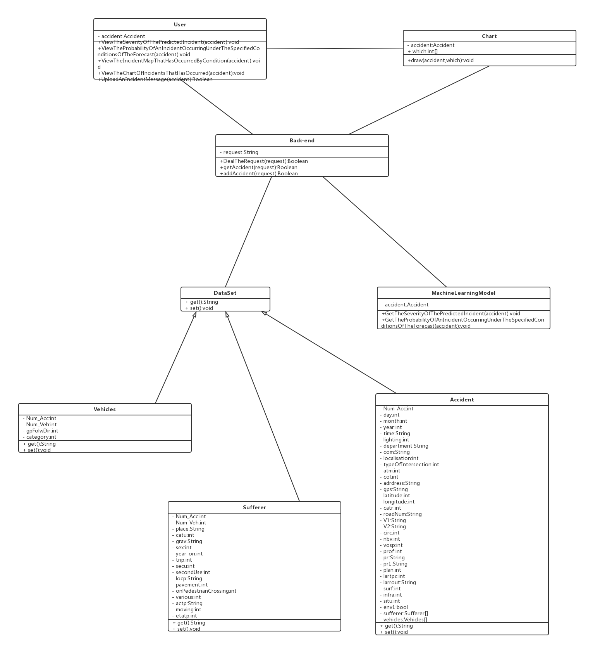
The Whole Class
·User, Chart
·Back-end
·MachineLearningModel
·Data Set

Slide 10
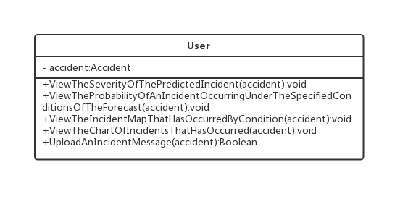
User
Users who use our products.

Slide 11
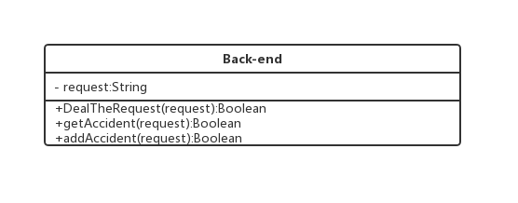
Back-end
The back end in our B/S Architecture.

Slide 12
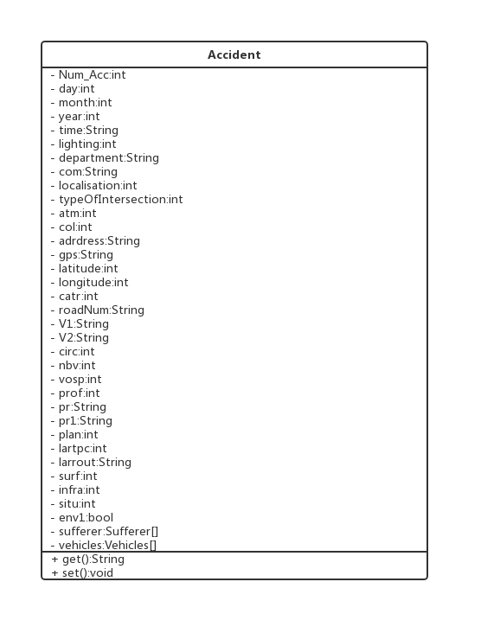
Accident
Specific information about the accident.

Slide 13
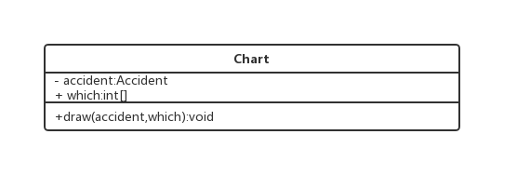
Chart
To present visual results.

Slide 14
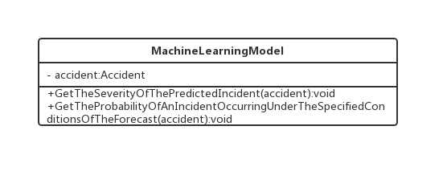
MachineLearningModel
A Machine Learn Model is going to predict the severity of an incident and the probability of an accident occurring under specified conditions.

Slide 15
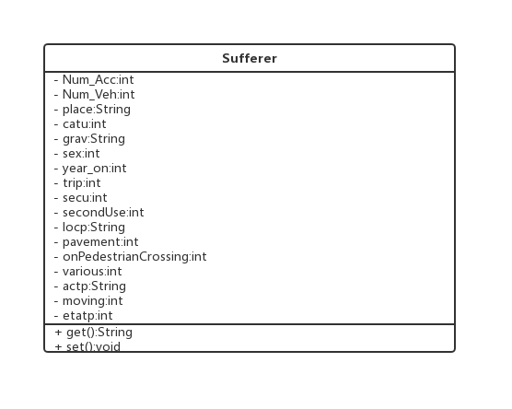
Sufferer
The person in accident.

Slide 16
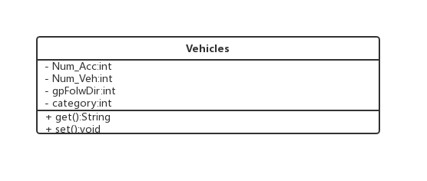
Vehicles
The vehicles in accident.

Slide 17
Sequence Diagram

Slide 18
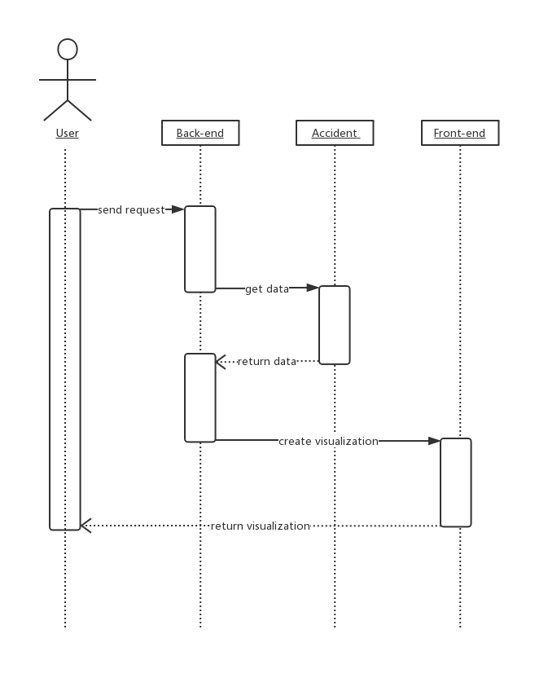
Visualize
Users can query the specified range of accidents, then get a visual map.

Slide 19
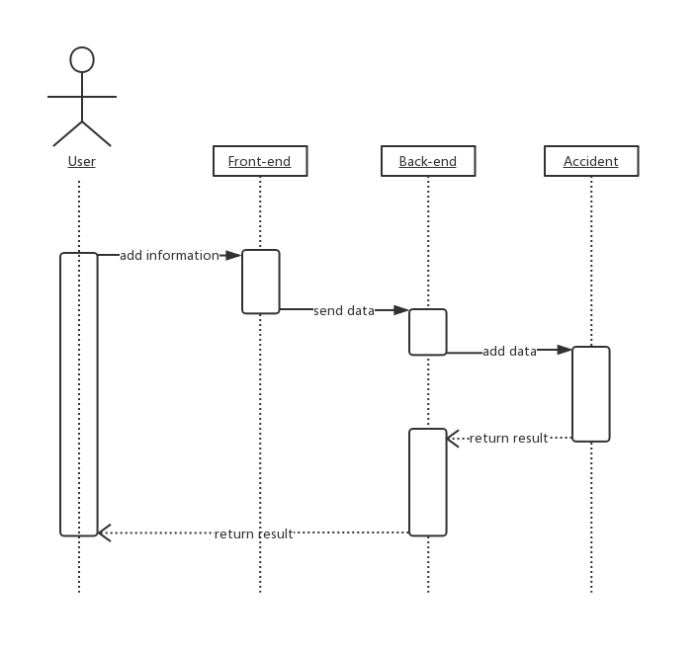
Upload
Users can upload accidents through our system.

Slide 20
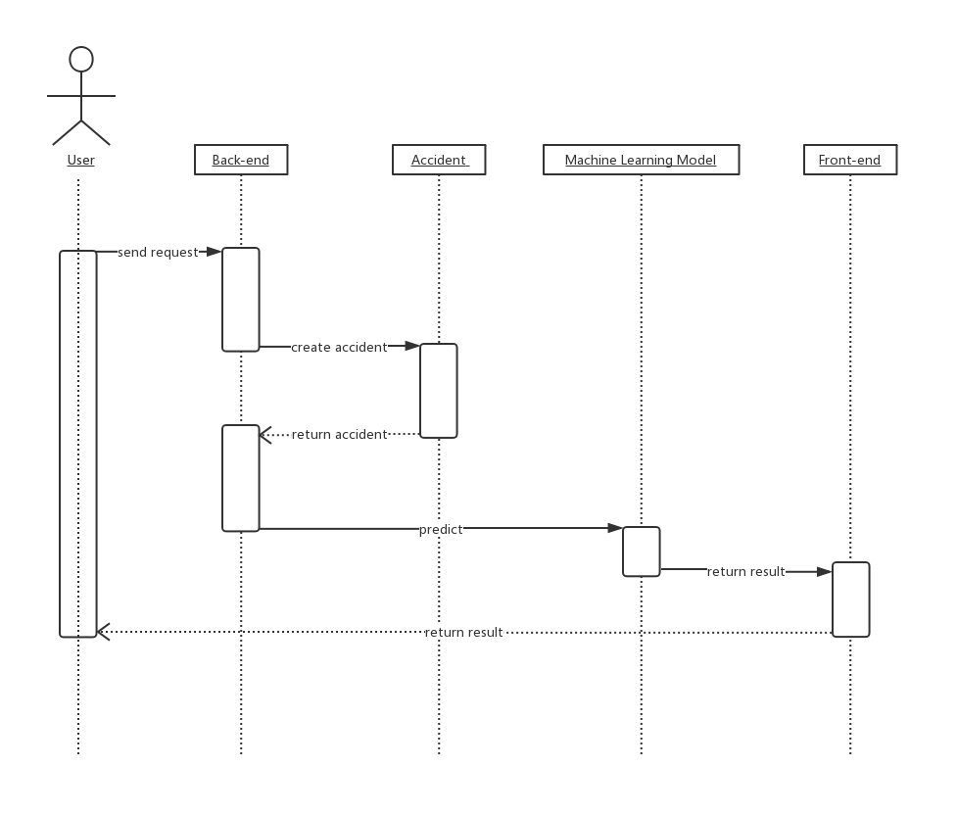
Predict
·Predict the probability of an accident occurring under specified conditions
·Predict the severity of an incident.

Slide 21
Elaboration

Slide 22
Machine Learning
Data processing
Prediction
Data cleaning(pandas),Dimensionality reduction(PCA，LDA，t-SNE)
sklearn
DecisionTree(predict deaths)
SVR(predict the probability of an accident)
Data analyze
Data interface
pandas,matplotlib,provide data needed for front-end visualization
python,pandas,csv to json

Slide 23
Data processing
Data Attributes in Our Dataset
caracteristics.csv
places.csv
date, lighting conditions, localisation,
Atmospheric conditions, type of collision, GPS coding...
category of road, Road Number, Traffic regime, Total number of traffic lanes, Drawing in plan, surface condition...
users.csv
User category, Severity of the accident, Sex of the user, Reason for traveling at the time of the accident,
On pavement, Action of the pedestrian...
Notes:
In the dataset, there are 3 csv files, which are caracteristics.csv, places.csv, and users.csv
These files detail the properties, accident locations, personnel and vehicles of every traffic accident that occurred in France between 2005 and 2016.

Slide 24


Data processing
Scraping and collect the data
First, merge the two files(caracteristics.csv and places.csv) through Num_Acc.
Second, delete columns that are not related to predicting by pandas.
Notes:
What we need to do is to predict the probability of an accident based on various environmental factors on the day of the location and to predict the level of casualties based on the accident that has occurred.
So the most useful of the three files for predicting are caracteristics.csv and places.csv.
There are many columns in our dataset that contain all aspects of the incident. But some columns don't help relative to the predictions, such as the address and the commune number.And there are several columns in the dataset that don’t have an introduction to it on the site, such as ‘agg’.
So I deleted these columns using pandas and got a new CSV file

Slide 25
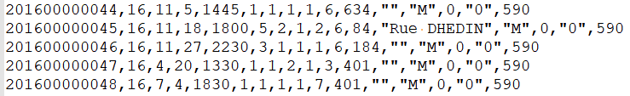
Data processing
Data cleaning and transformation
First, delete items with invalid data.
Second, Data type conversion
After data cleaning, the effective data is about 24,000
Notes:
The latitude and longitude column contains a large number of 0 and null, and the other columns also contain a lot of null data. So I need to delete these data by pandas.
In the attribute longtitute, since the longitude range of France is from 5 degrees west longitude to 9 degrees east longitude (the number range is (nagetive5~9)) and the longitude value of scientific notation exists, the type of this attribute is a string. So I need to convert the string to number

Slide 26
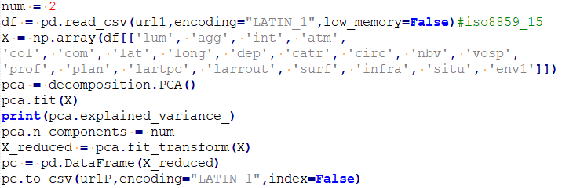
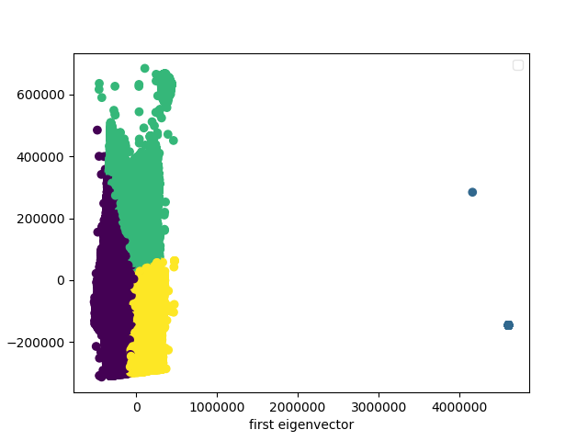
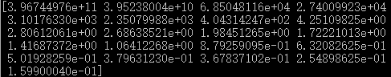
Data processing
Principal component analysis
Notes:
Then I can delete the lowest importance features and make a scatter plot of the data using the first and second eigenvenctor.
The three color regions in the figure are made using the first and second eigenvenctor of the PCA results, representing accidents that occur in different latitude and longitude regions, respectively. The two right-point data can be seen as the wrong data, so delete it.

Slide 27
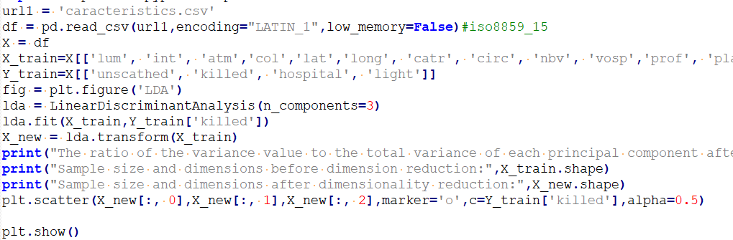
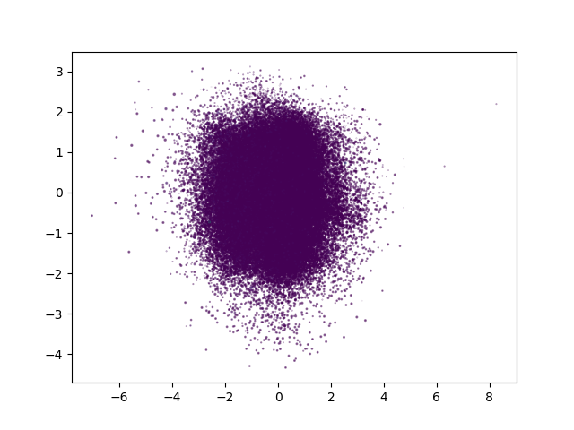
Data processing
Latent Dirichlet Allocation

Slide 28
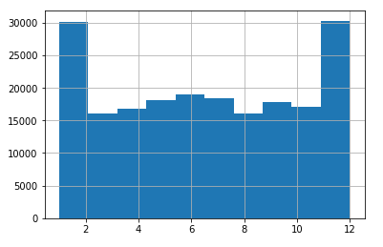
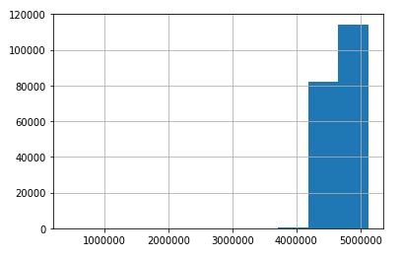
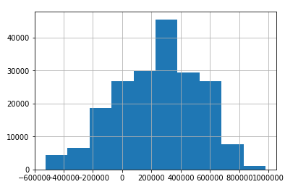
Data processing
Analysis of the dataset
month
Lat Long
Other than that, most of the other properties in our dataset are discrete options.
Notes:
Calculate the option that has the most occurrences of each column in our dataset
This picture shows the number of accidents in each month. It can be seen that the month from November to the second year is the peak of the accident, and the number of accidents is nearly twice that of other months.
The above two figures show the aggregation of different latitude and longitude accidents.The true value of latitude and longitude needs to shift the decimal point of the coordinates in the graph to the left by 5 digits.We can see that more accidents occurred between 2-4 degrees east longitude.Then the accidents on both sides of the area are gradually reduced

Slide 29
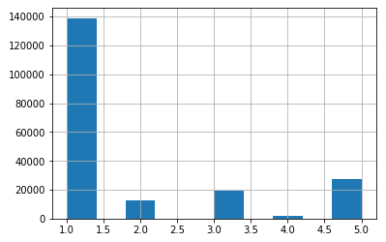
Data processing
Analysis of the dataset
1 - Full day
2 - Twilight or dawn
3 - Night without public lighting
4 - Night with public lighting not lit
5 - Night with public lighting on
lighting conditions
Notes:
This picture depicts the number of accidents under different lighting conditions.

Slide 30
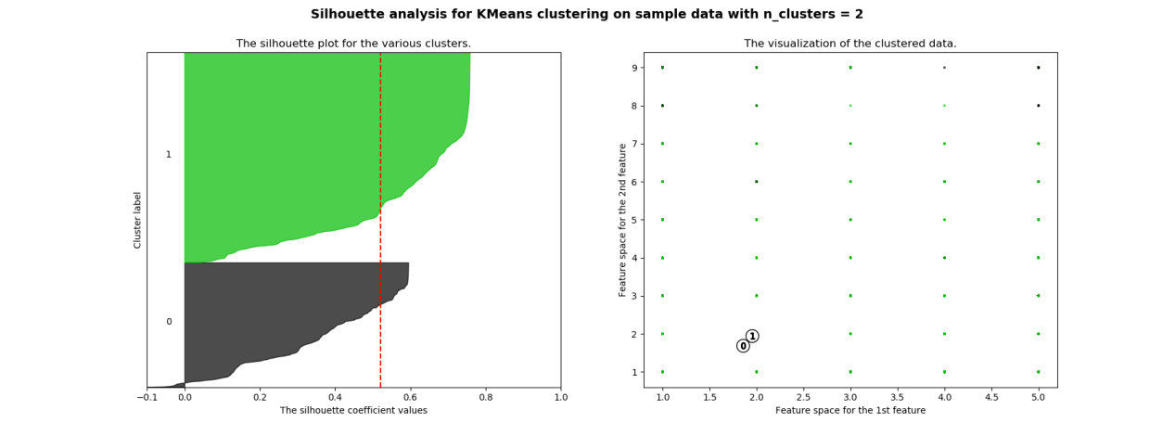
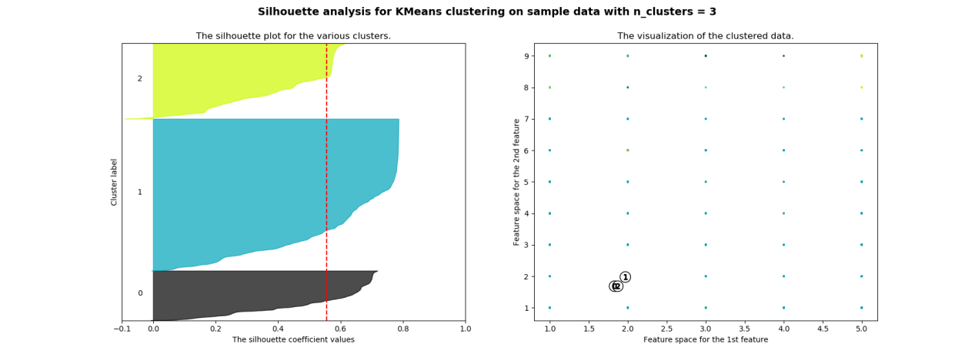
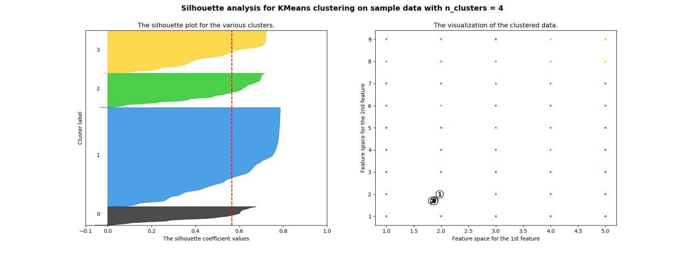
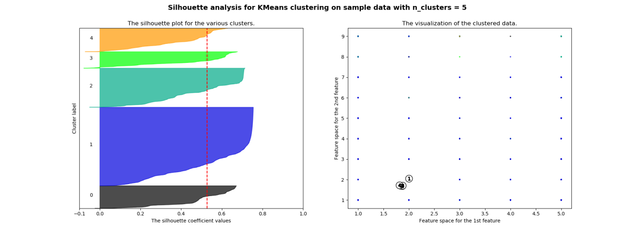
Data processing
Clusting
Silhuette Analysis
Notes:
I don't think these clusters have a particularly good effect. But I think when n_clusters equals 3 is best now.

Slide 31
Construction

Slide 32
Machine learning
Predicting deaths
Classification
DecisionTreeClassifier()
Predict the possibility of an accident
Regression
svm.SVR()
Notes:
We have two predicting features

Slide 33
Predicting deaths
Predicting the number of unscathed, killed, hospitalized wounded and light injury in an accident by decision tree classification
First, add four columns of attributes to caracteristics.csv, which are unscathed,killed,hospital and light. The functions are called users.csv to calculate the number of people in each incident.Then divide the data set into two parts: training data and test data.
Train:200,000 datas Test:40,000 datas
Notes:
In this function, we are prepared to predict the number of minor injuries, deaths, hospitalizations, and injuries not injured in the accident by user-entered conditions.
the number of deaths, minor injuries, hospitalizations, and uninjured persons are the target values.

Slide 34
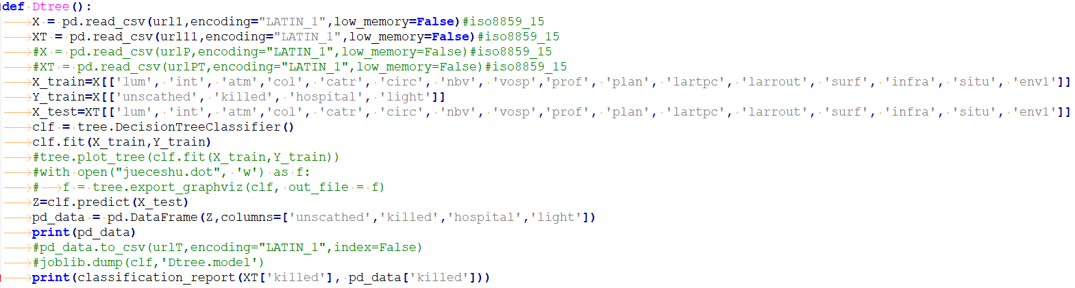
Predicting deaths
Select machine learning model
The number of people we want to predict is a discrete value, so in the choice of model, we should choose the classification model.
We selected multiple models for training, and selected the Decision tree model by evaluating the results of the models.
Notes:
In this function, we are prepared to predict the number of minor injuries, deaths, hospitalizations, and injuries not injured in the accident by user-entered conditions.

Slide 35
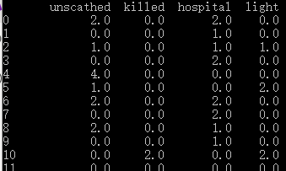
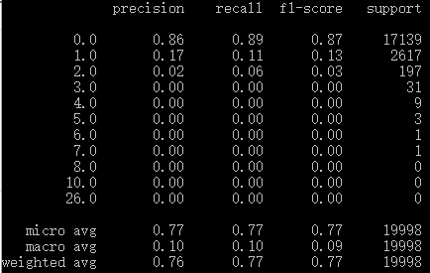
Predicting deaths
Model prediction accuracy

Slide 36
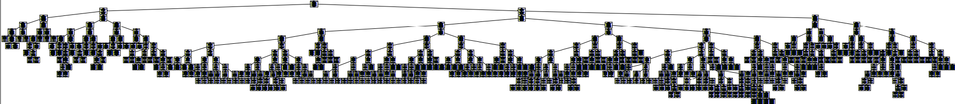
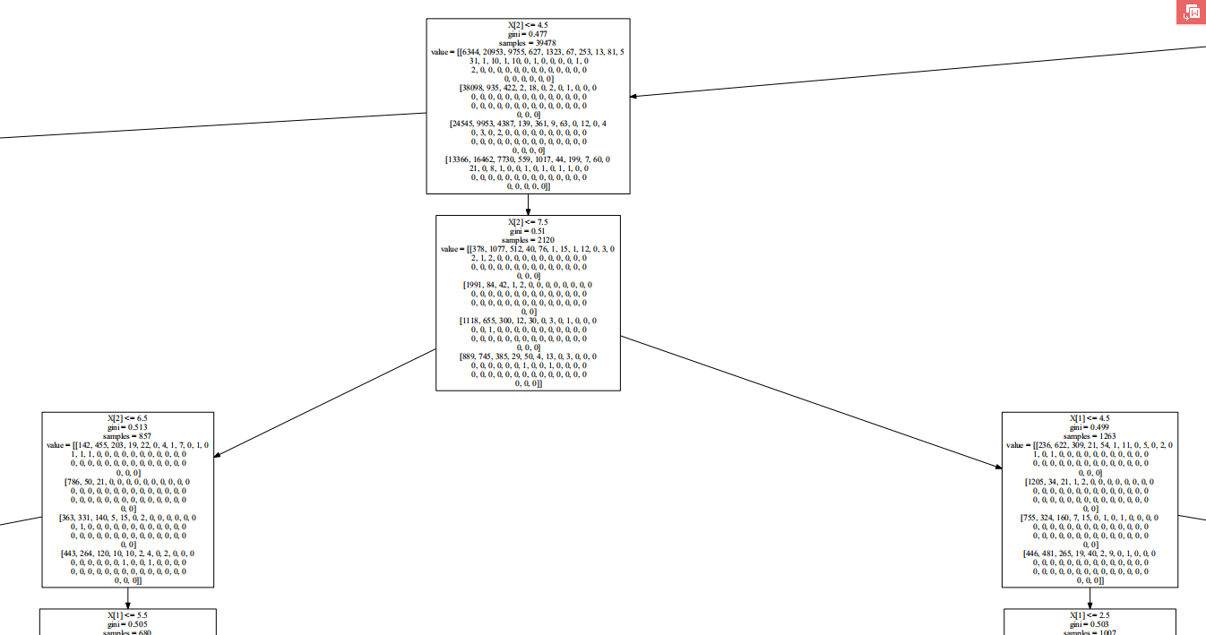
Decision Tree

Slide 37
Predict the possibility of an accident
In this function,We are prepared to predict the possibility of an accident under certain conditions in France.
First, Add the attribute chance and set the chance value of the present datas to 1.
Randomly generate new data marked the chance in 0
the chance is the target value.
Notes:
the chance is the target value.

Slide 38
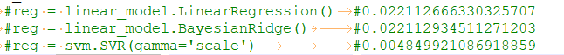
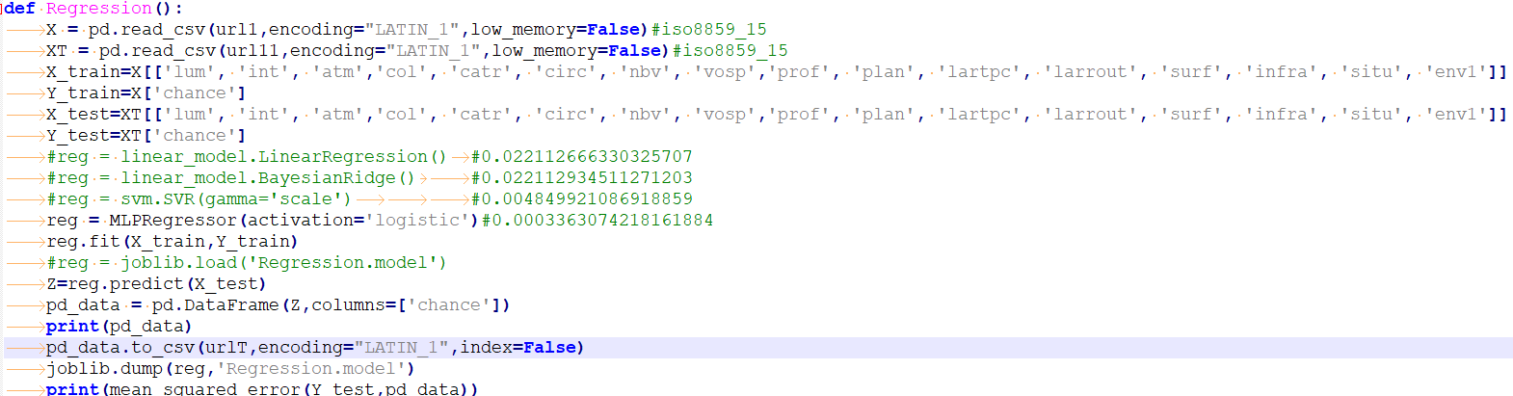
Predict the possibility of an accident
Select machine learning model by MSE
Notes:
The number of people we want to predict is a continuous value, so in the choice of model, we should choose the regression model.
I selected multiple models for training, and evaluate model accuracy with MSE.
Finally we chose the SVR as the predictive model.

Slide 39
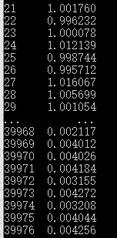
Predict the possibility of an accident
MSE Error：

Slide 40
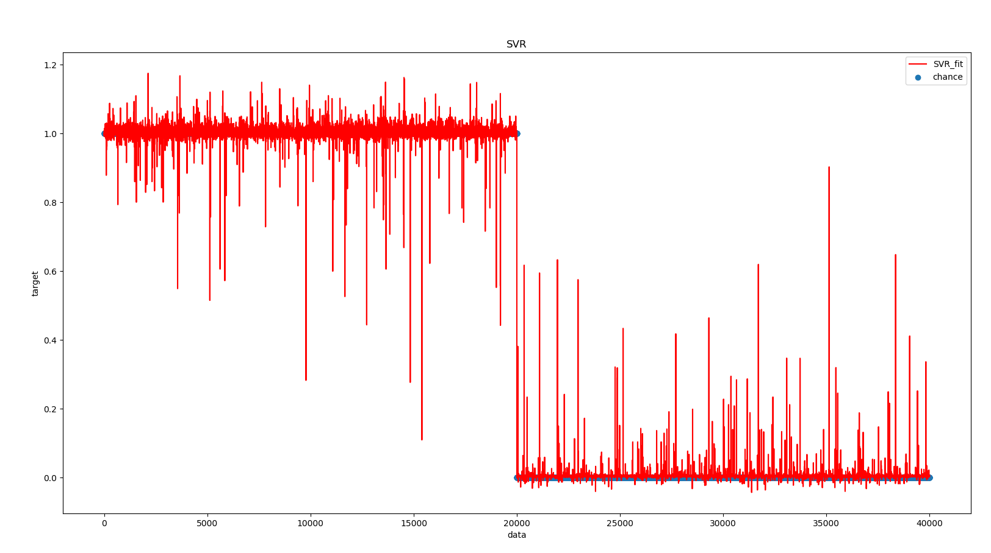
Predict the probability of an accident
Notes:
This chart is the result of regression prediction using the SVR model.
I think that using the SVR model achieves a good regression effect.

Slide 41
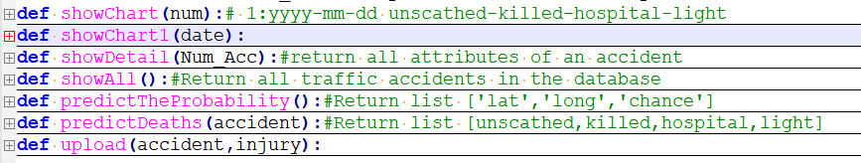
Data interface
Save and read the model of machine learning training with the joblib module
Provide predictive data and visual data to the front end

Slide 42
Visualization

Slide 43
Analysis with Visualization - Tools
Python
Matplotlib
HTML+CSS+JS
Jquery
Bootstrap
Vue
JSON
Google Maps
Baidu ECharts
Most of the data in our data is obtained in real time by AJAX.

Slide 44
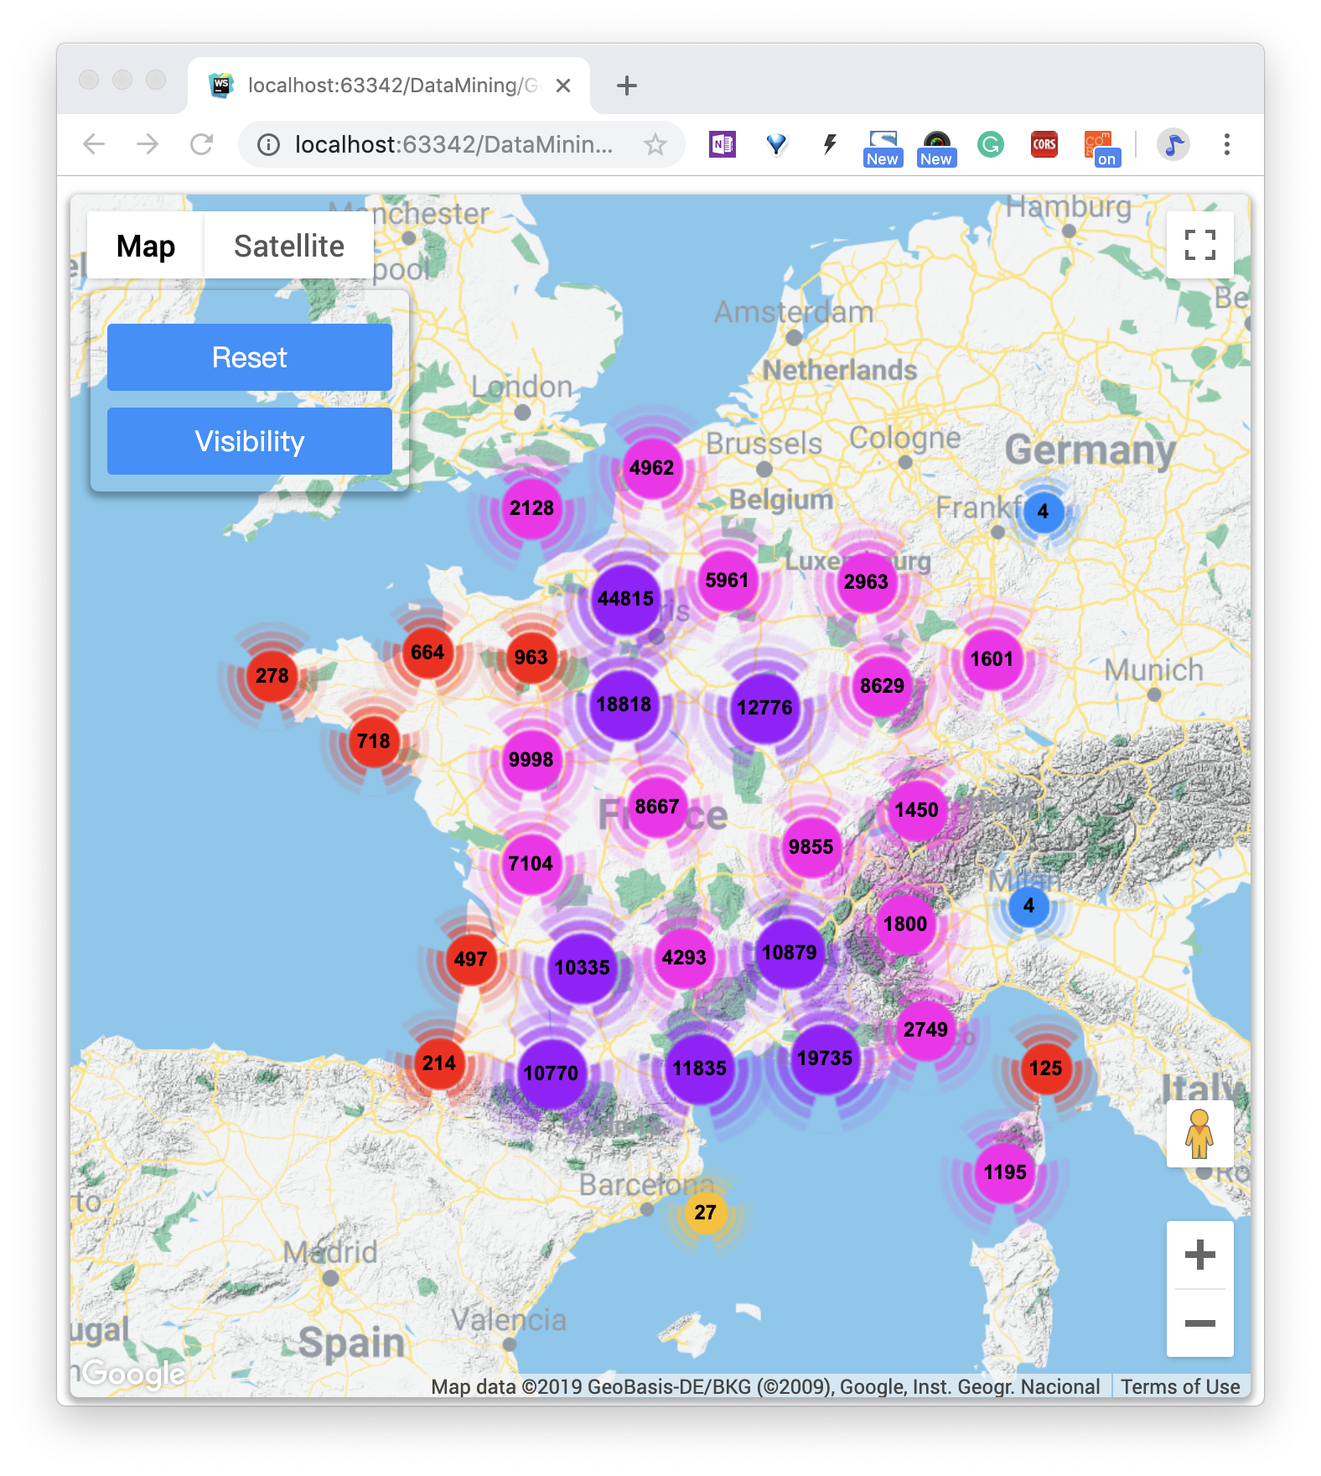
① Clustering map with existing traffic accident data
I used Google Maps as a canvas to draw the most effective and useful 200,000 pieces of data from 800,000 pieces of original data, mark them on the map with their latitude and longitude, and cluster them. The clustering principle is to calculate the number of markers in a grid of a specified size, and calculate the cluster icon and number of markers in the center. The cluster icon has five colors and is adjusted according to the size of the data. From high to low, it is purple, pink, red, yellow, and blue.

Slide 45
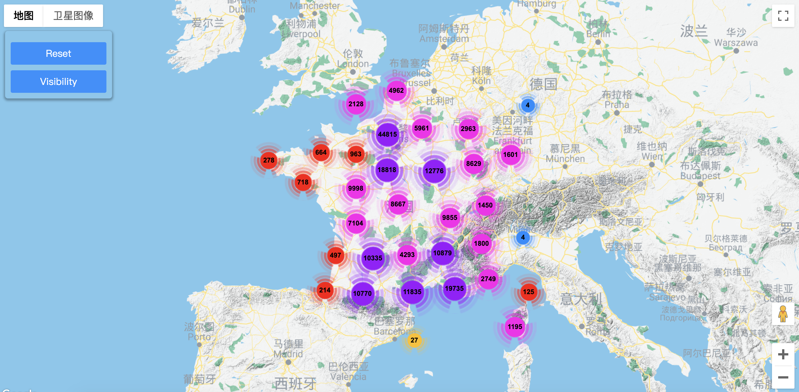

Slide 46
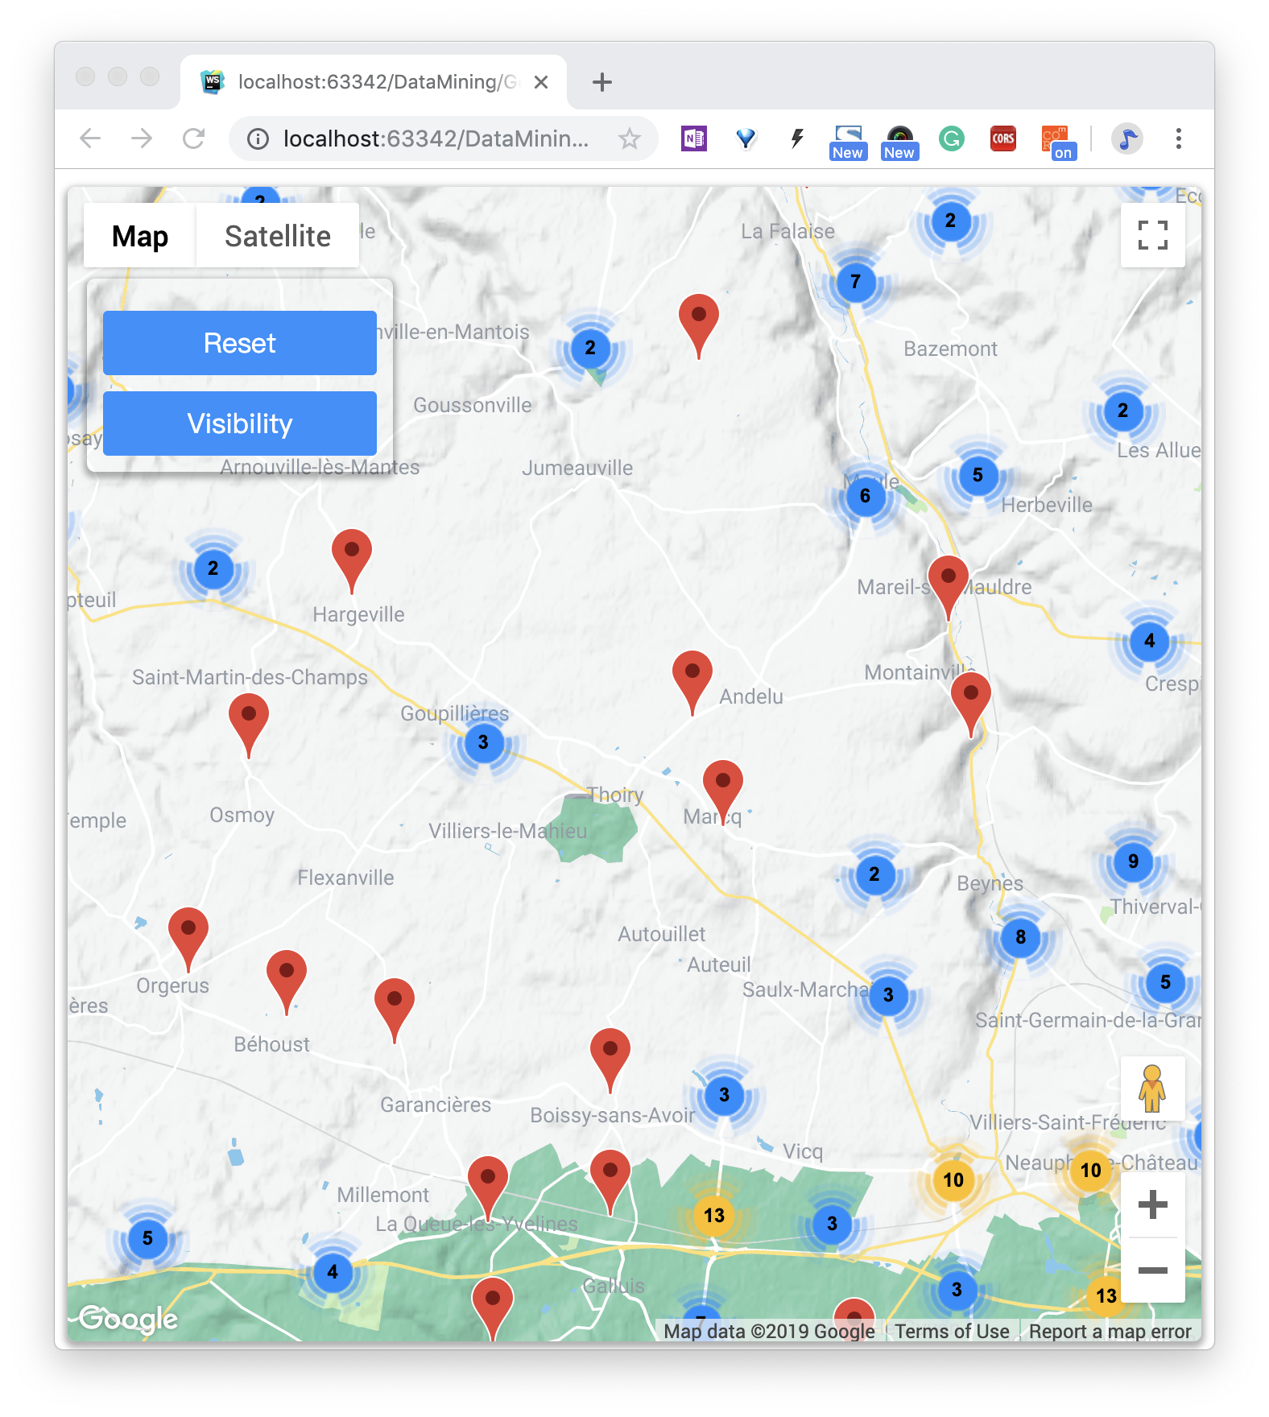
Significance: Through clustering, we can observe the number of traffic accidents in various places and the severity of their representatives from a discrete perspective, which helps us to allocate the number of traffic police or staff.
Interactive part:
- Like all normal Google Maps, we can semantically zoom and drag maps with the mouse wheel or trackpad
- Click on each cluster icon to enlarge the screen to the grid represented by the cluster icon, and re-cluster the markers in the current range to display the new cluster.

Slide 47
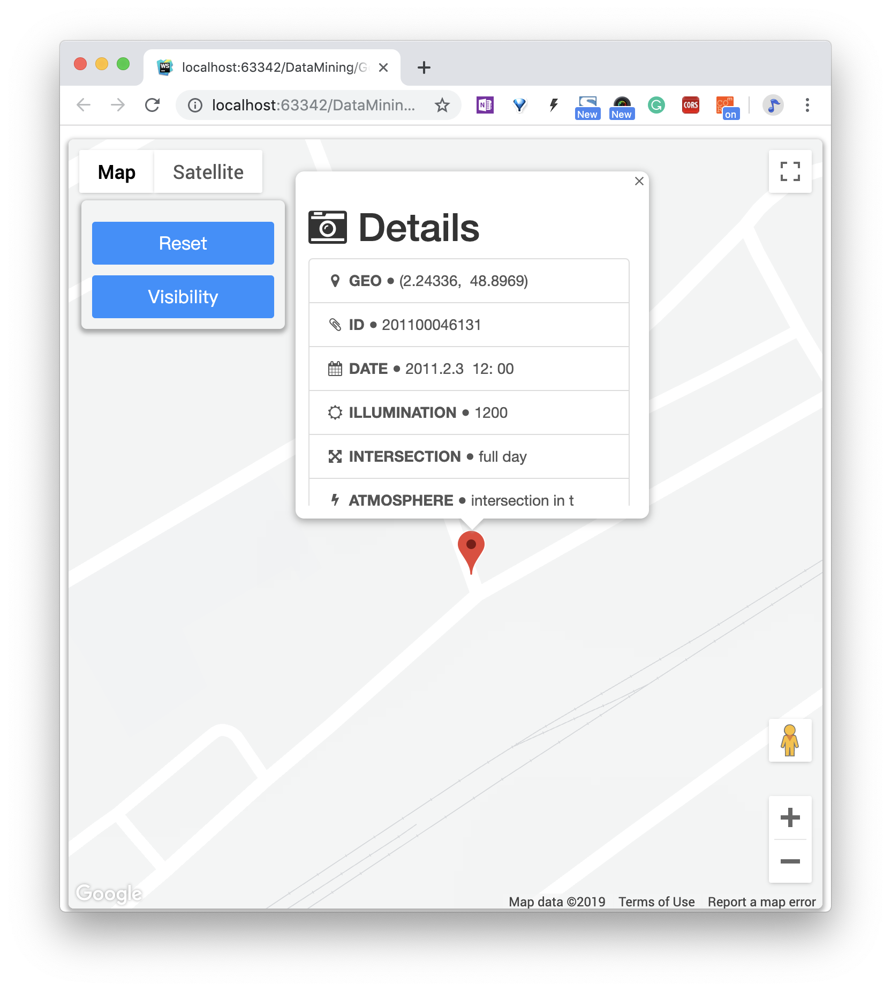
- Finally we can click on the individual traffic accident marker to open the information window and view the details of the incident.

Slide 48
- We can click the Reset button on the left to return to the initial zoom and position.
- We can click on Visibility button to hide or show the cluster icon
summary:
- From these figures, we also verified that our data set is very accurate, and it can be seen intuitively and clearly from the map that most of the accidents occurred at the intersection and also met the data in the record.
- At the same time, the data itself is basically in line with an abundant of accidents in big cities and a few accidents in suburban counties. Especially in Ile-de-France where we living now, famous French Riviera in the south of France.

Slide 49
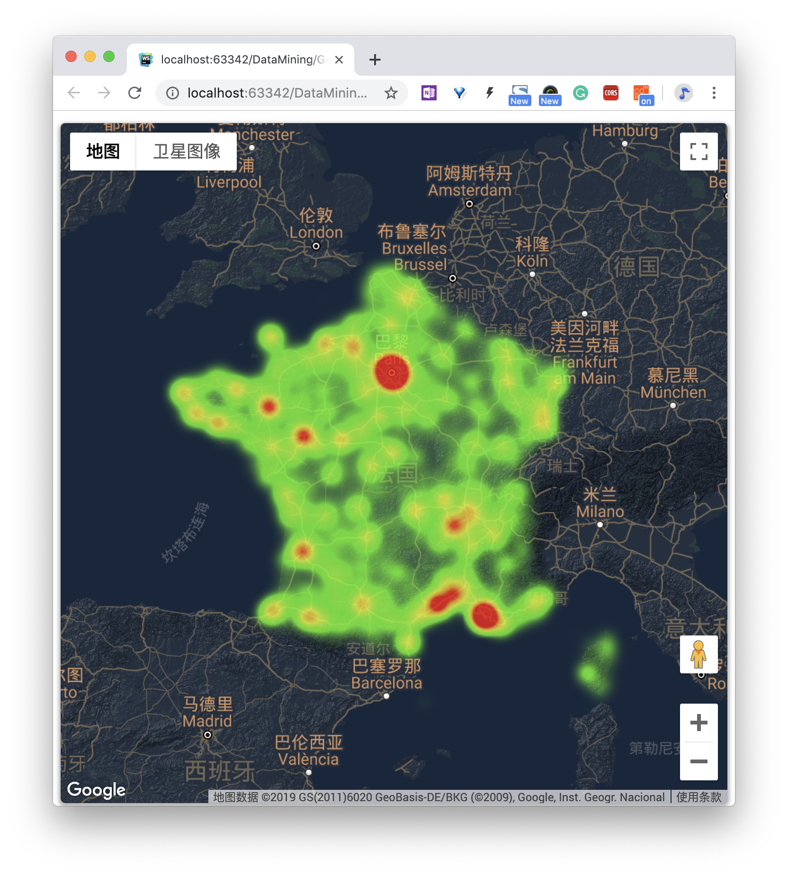
② Heat maps with exsisting accidents
Form: By converting discrete data points into continuous heat maps, we use the existing data density to roughly simulate the probability of occurrence of a region. In terms of color depth, red, orange, yellow, and green represent the severity of the decrease. A custom dark background also helps us see the effects of the heat map.

Slide 50
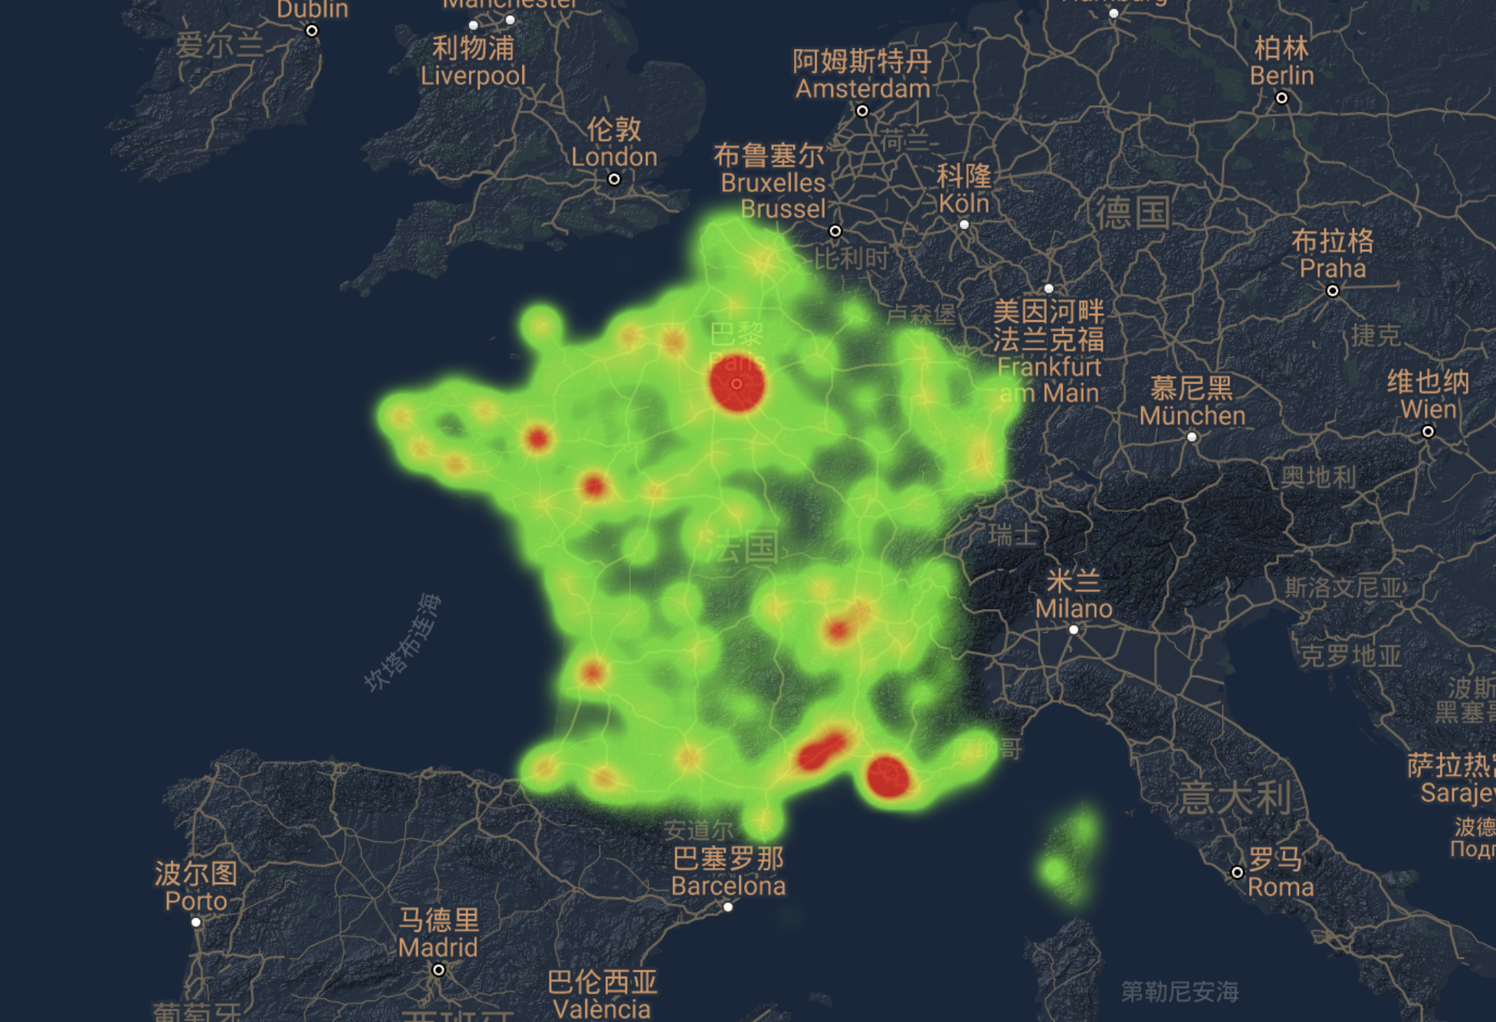

Slide 51
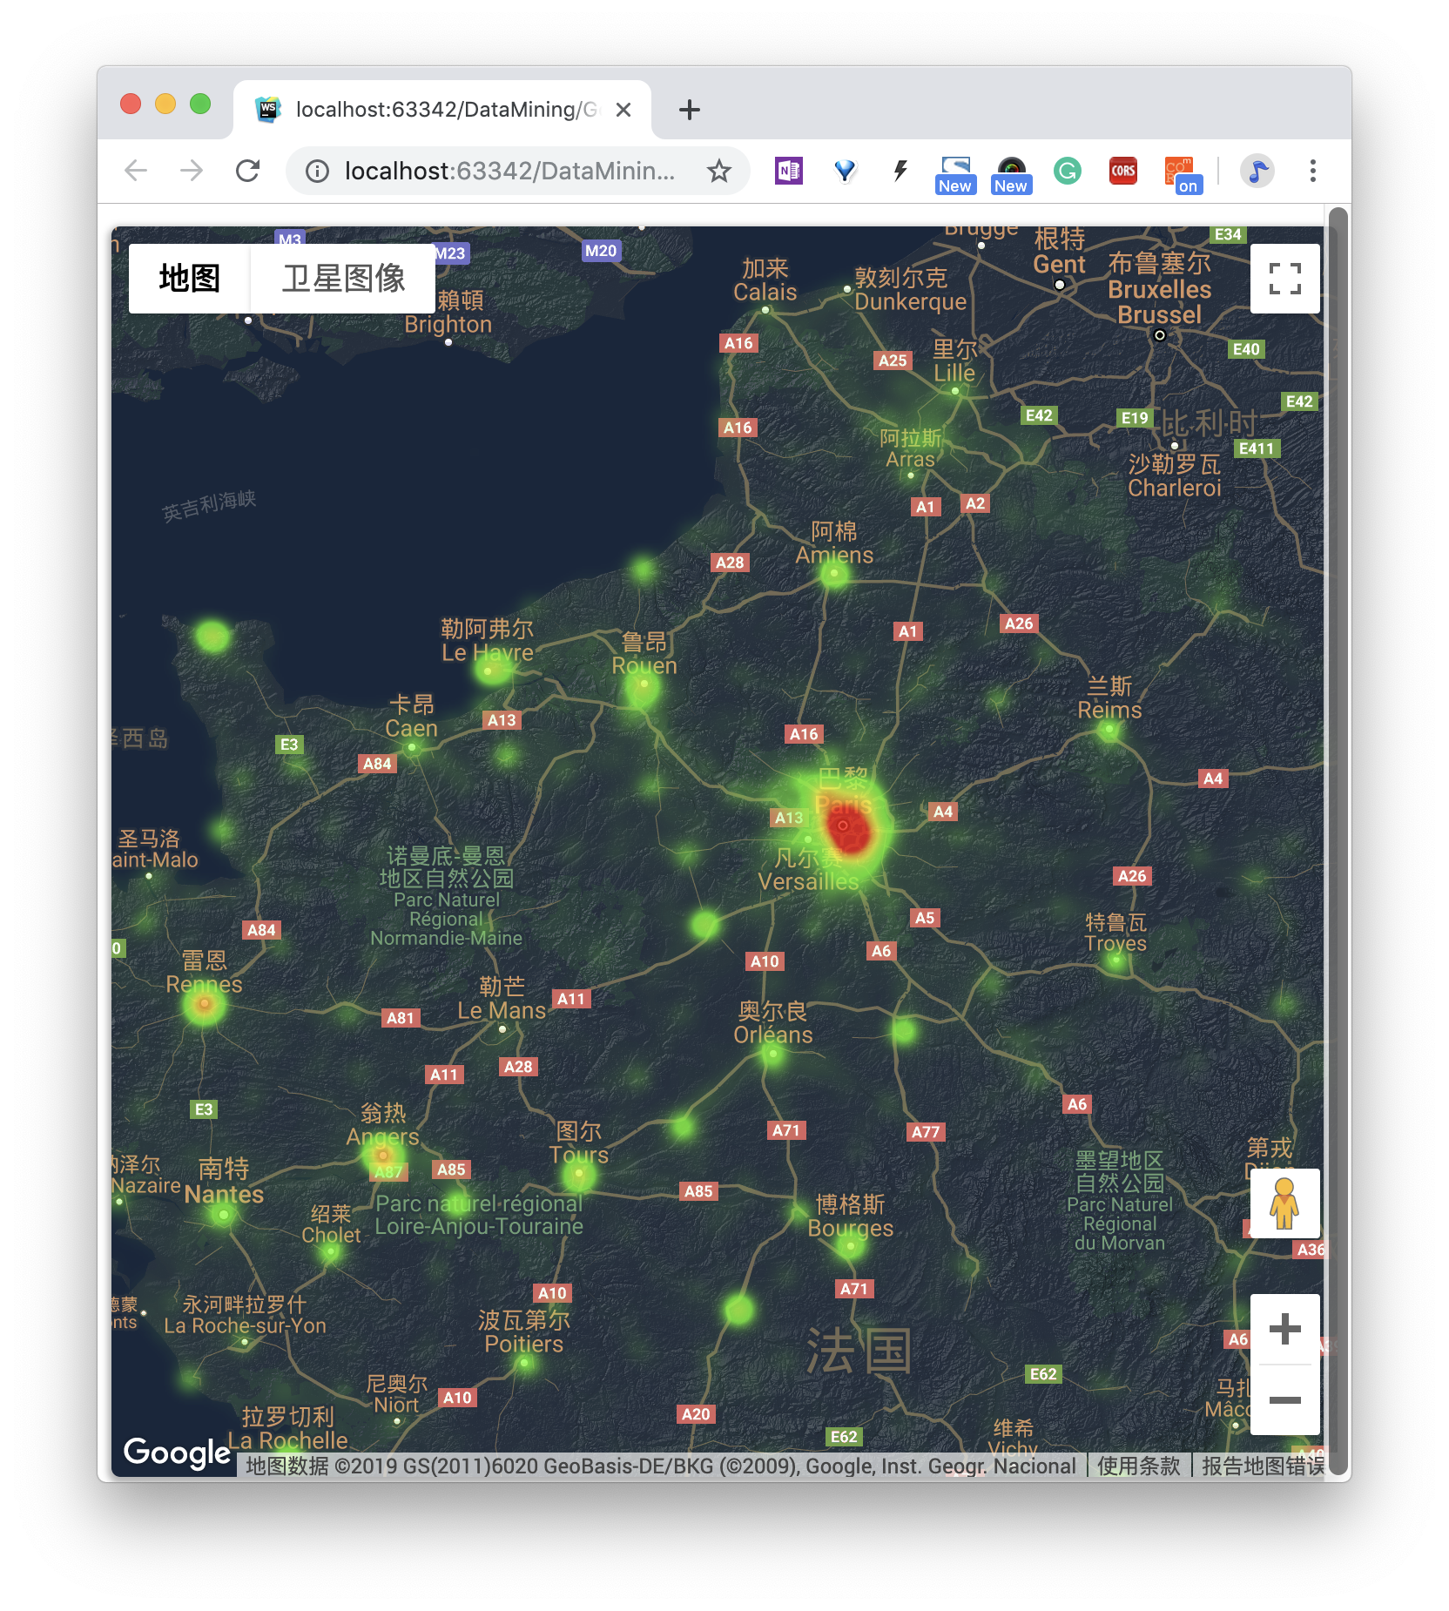
Interaction:
- Double-click on an area to zoom in to see the re-rendered heat map for that area.

Slide 52
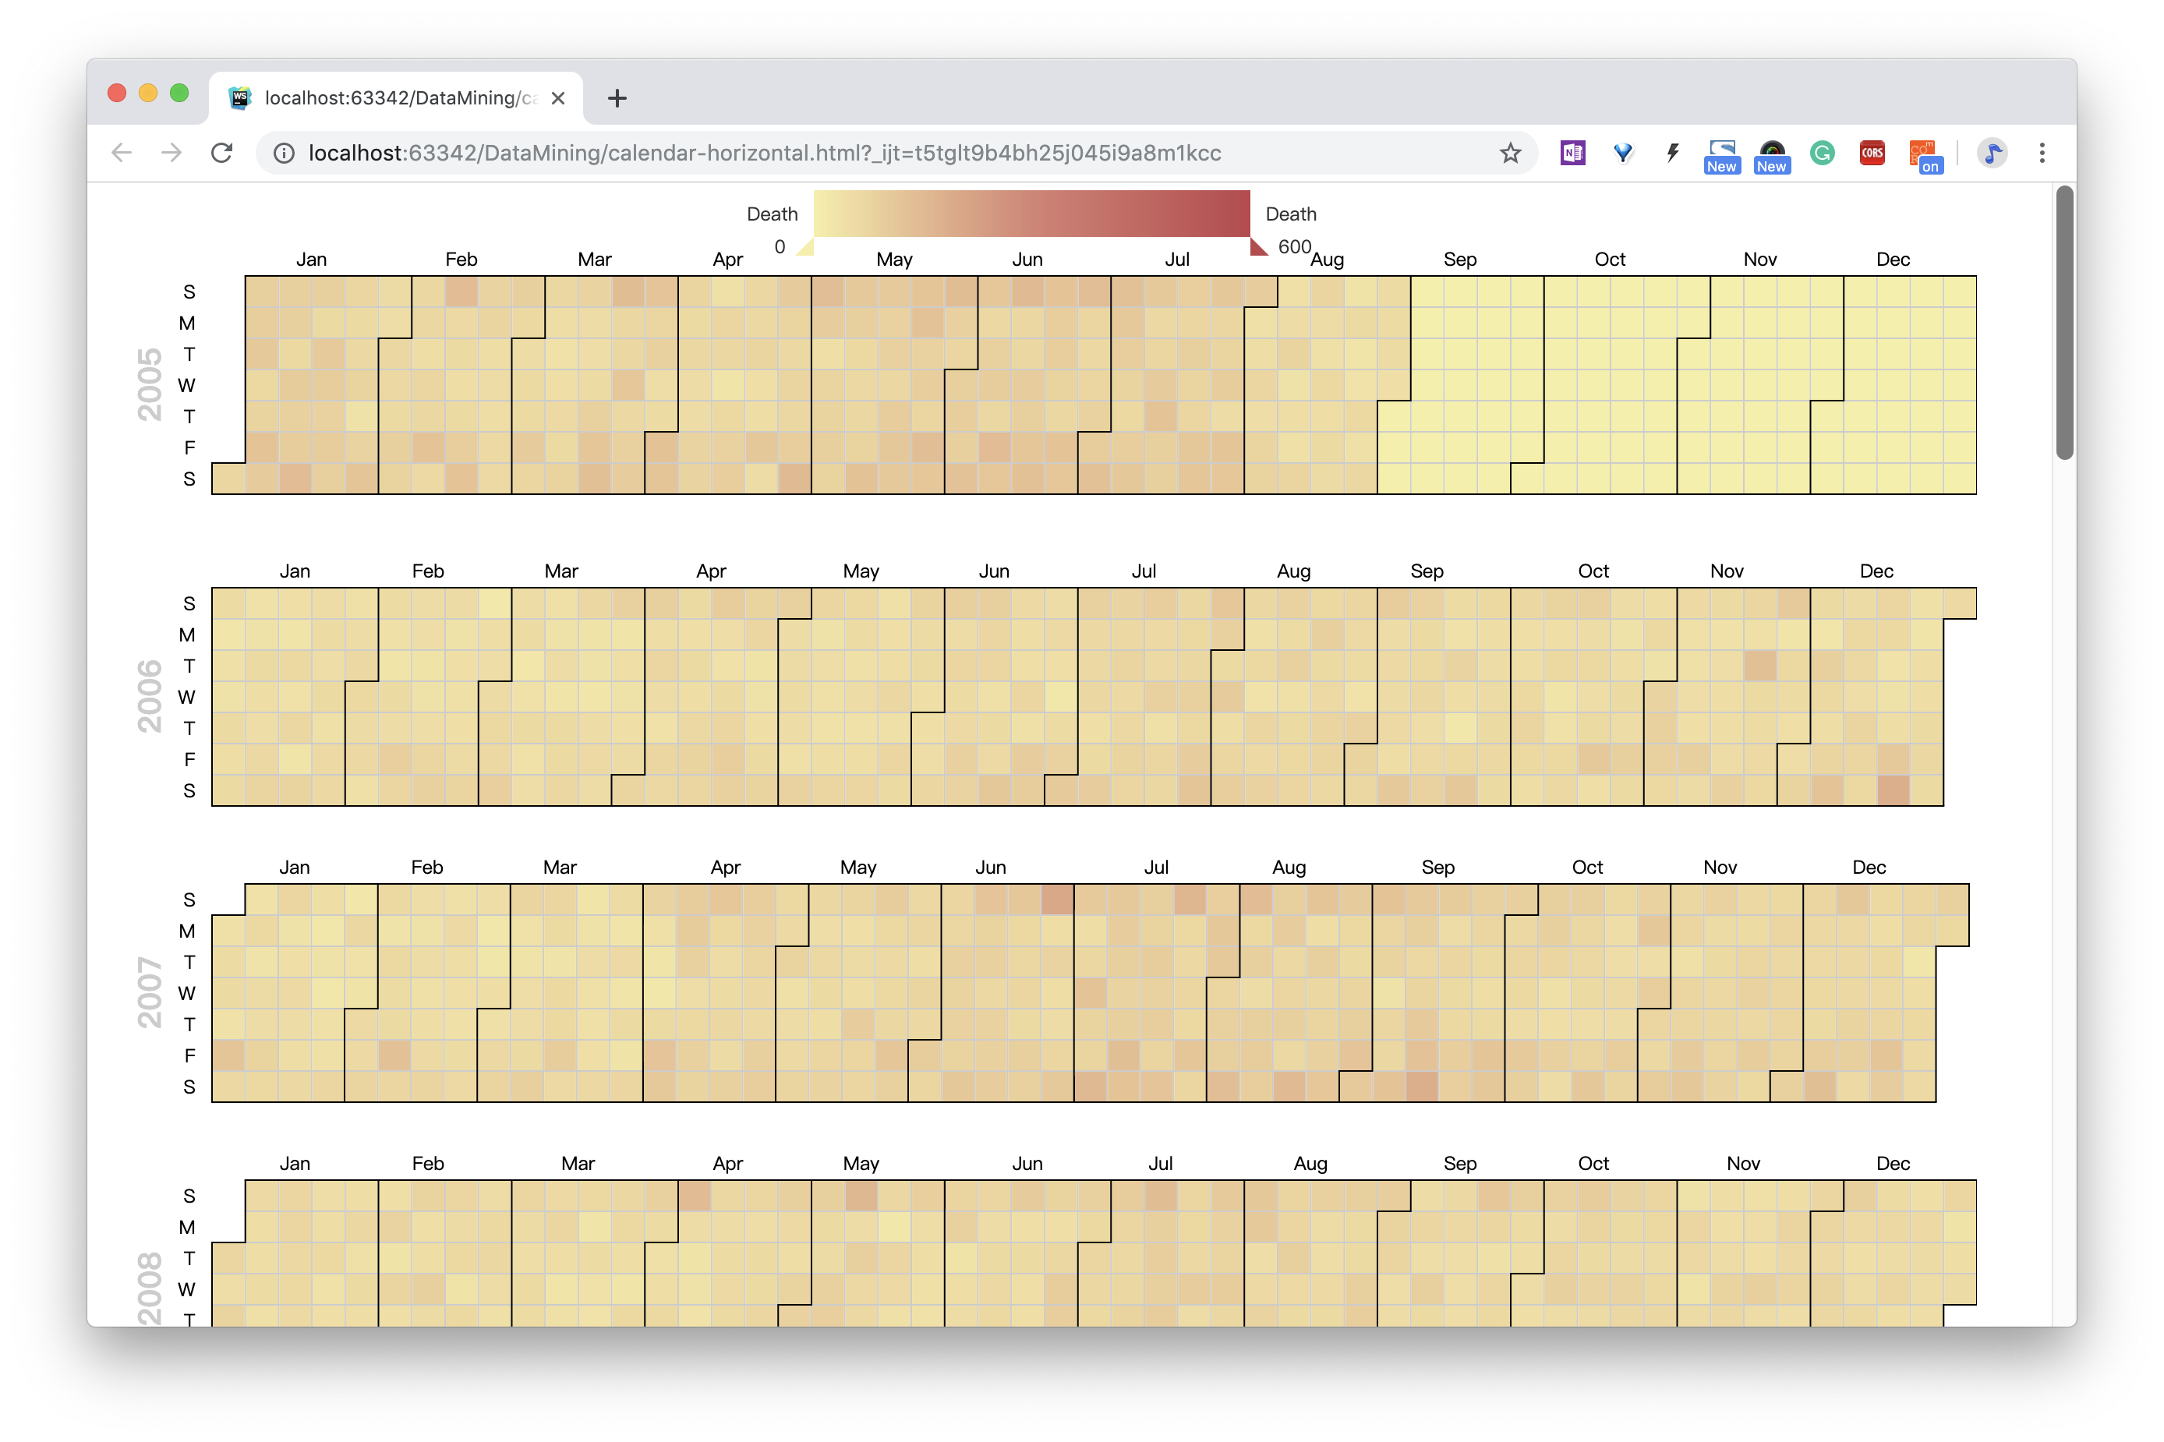
③ Calendar-type heat map of the number of deaths per day for the whole year of 2005-2016
Introduction: In this picture, I put all the years together. Each year holds a large grid, and is divided into weeks and months by the grid. The color depth of each grid indicates the number of deaths, from yellow to red . At the top of the diagram is a visual mapping control.

Slide 54
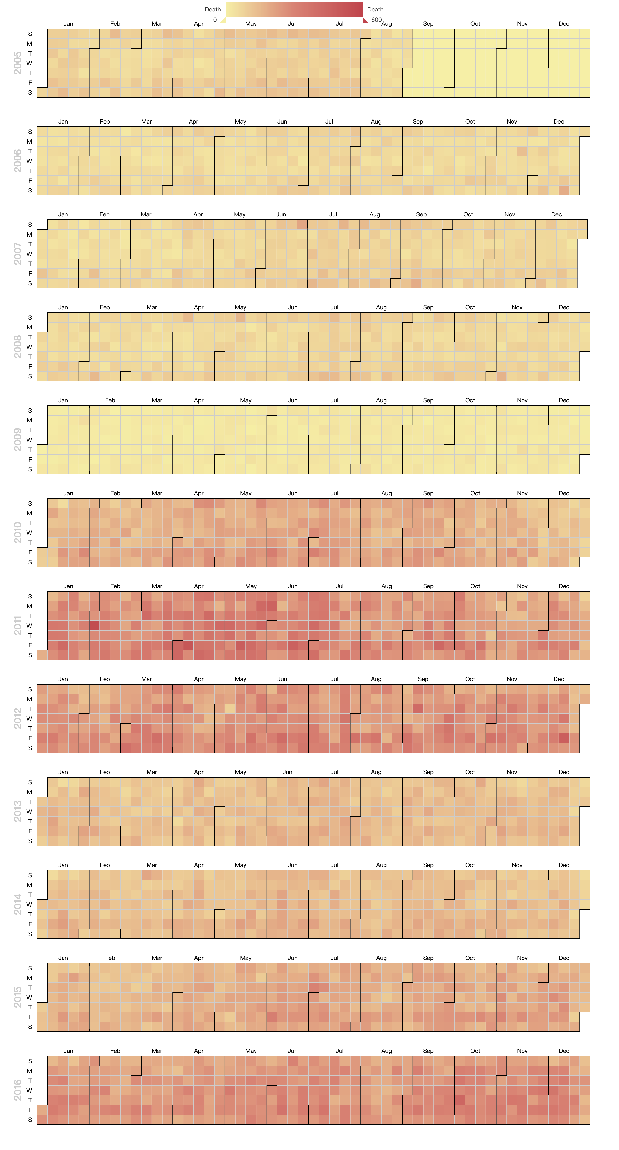

Slide 57
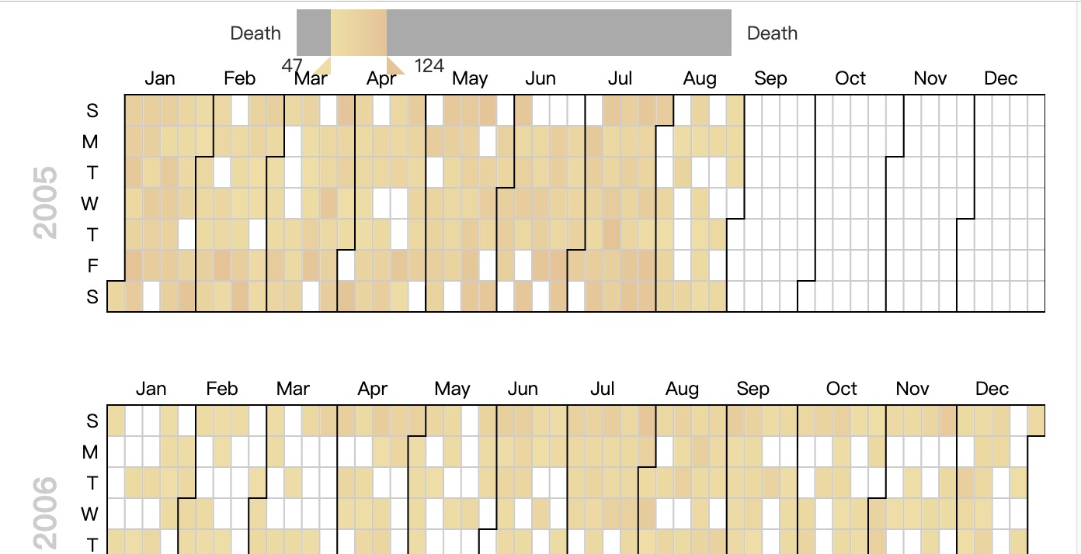
Interaction:
- When the mouse moves over the map control, the square of the value represented by the mouse position is highlighted.
- The mouse can drag the left and right range of the mapping control. The default is all (0-600 people). After dragging, only the color blocks of the specified range will be displayed.

Slide 58
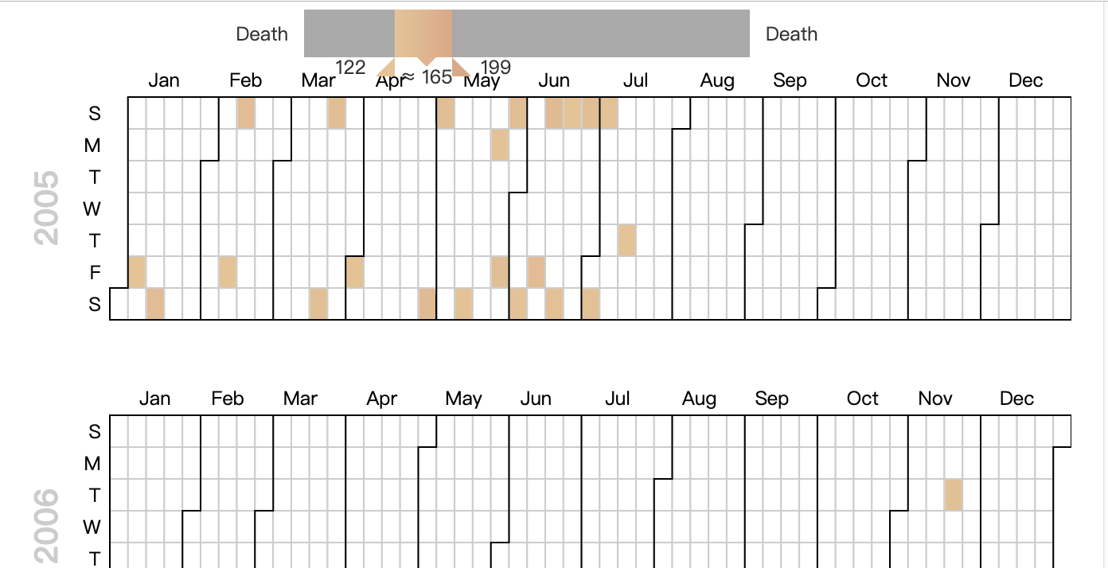
- After specifying the range, you can drag this range to change the selected value.

Slide 59
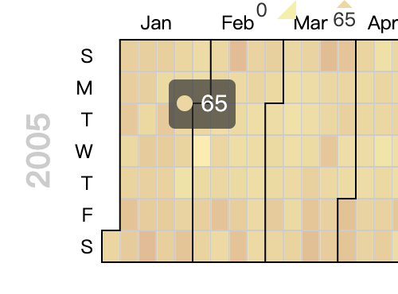
- When we move the mouse over a color block, the color block will be highlighted and the number of deaths represented by the color block will be displayed above
Summary: We can see that the number of traffic accidents in France and before 2009 was small, and it has increased significantly since 2010.

Slide 60

④ Calendar-pie diagram with Inquiring about the number of traffic casualties per day of the month by month
Introduction and interaction:
- The center of the graph shows the monthly calendar for the specified month. There is a pie chart in each day. There are four pie charts: death, hospitalization, minor injury(light), no injury(unscathed), expressed in four colors.
- There is a category selector below, you can click to hide or display the type of pie chart that responds, freely combine categories or display only one category

Slide 61


Slide 62

Introduction and interaction:
- The center of the graph shows the monthly calendar for the specified month. There is a pie chart in each day. There are four pie charts: death, hospitalization, minor injury(light), no injury(unscathed), expressed in four colors.
- There is a category selector below, you can click to hide or display the type of pie chart that responds, freely combine categories or display only one category

Slide 63


- When the mouse is placed on any arc, the type value of the arc is displayed.
- Click on the calendar control below to select the month you want to query, and click the Query button to find the corresponding data.

Slide 64

⑤ The Real-time prediction Map of the probability of traffic accident
Introduction and interaction:
After accessing the meteorological department and the real-time traffic status API, we can predict the real-time probability of traffic accidents in the relevant area.
In order to show that we specially selected some scenes to simulate the access to the real-time information API, the radius of the circle is related to the probability. The larger the probability, the larger the radius of the circle. After clicking on the circle, you can see the probability of a traffic accident it represents above.

Slide 65


Slide 66

⑥ Number of people predictive results visualization with radar diagram and location map
Introduction: We display the predicted death, medical treatment, minor injury, and injury-free number of designated accident conditions through radar chart, and display the location corresponding to latitude and longitude.

Slide 67


⑦ Punch card with the data of Week and 24 hours from 2005 to 2016
Introduction:
- The abscissa is a 24-hour segment and the ordinate is a seven-week segment. The corresponding position of the horizontal and vertical coordinate intersection is one punched hole, and the radius of the hole is determined according to the number of people. The data for each well is the sum of the values represented by the week and time for the 2005-2016 data.
- In the upper right corner is a sort selector that allows you to select the corresponding punch map.

Slide 68


Slide 69

- Place the mouse on the corresponding hole to view the specific value
summary:
- Through the radius and intensity of the holes, we can clearly see the severity of the accident at each time period. For example, we can see that the accident occurred at 5-6 pm and Friday and Saturday.

Slide 70
Architecture

Slide 71


Slide 72

Technology Selection
Python 3.5.2
Used to load our machine learning model and do some logic.

Slide 73

Technology Selection
Flask 1.0.2
Used to deploy our back end onto internet.

Slide 74

Technology Selection
Gunicorn 19.9.0
Used to load flask project on the designated port in server.

Slide 75

Technology Selection
Nginx 1.12.2
Used to load front end and reverse proxy the back end.

Slide 76

Technology Selection
Bootstrap 4.1.1
Used to beautify the interface.

Slide 77

Flask
The Controller of the back end.
There are 6 methods available to response the requests from the front end.

Slide 78

Nginx
If the http method is post, the nginx server will proxy it to the back end API.
If the http method is not post, such as get, it will response it normally.

Slide 79

Language
At first, we will automatically detect your browser language.
Also, you can choose your favorite language you like. If you do it, we won't change your language any more until you change it by yourself or flash cookies.

Slide 80
Demo & Test

Slide 81

The Home Page
6,000
The home page is just like this, there is a top navbar to link different funtion and there is a setting button on the left top to change the language.

Slide 82

The Upload
6,000
The user can upload any accident which occur around him and we will put it into visualization once we have checked it correctly.

Slide 83

The Predict of Deaths
6,000
We can use deaths predict function to predict the number of deaths(include unscathed, killed, hospital and light) in an accident which user want to know.

Slide 84

The Predict of Deaths
And this is the result
Now, we can see the predicted result of four kinds of people and also can see the really localtion on the map.

Slide 85

The Predict of Probability
6,000
Because of missing the details of real road data, we intend to leave this part to professionals such as the state. If they upload the real information of every road, this map will show you the probability of an accident at these locations. But now, it just a mock information.

Slide 86

Visualization on Punch Card
6,000
In this part, we can clearly see the number of people who have accidents every week and every hour. So it can tell us when is the most dangers time.

Slide 87

The Visualization on Map
6,000
We can visit all the data(200,000 items) on this map and can zoom in and out anywhere. What's more, if we click one accident, then the details of this accident will show out by a list.

Slide 88

The Visualization on Map
6,000
标题数字等都可以通过点击和重新输入进行更改，顶部“开始”面板中可以对字体、字号、颜色、行距等进行修改。

Slide 89
The Visualization on Map
6,000
We can visit all the data(200,000 items) on this map and can zoom in and out anywhere. What's more, if we click one accident, then the details of this accident will show out by a list.

Slide 90

Visualization on Heat Map
6,000
标题数字等都可以通过点击和重新输入进行更改，顶部“开始”面板中可以对字体、字号、颜色、行距等进行修改。
This map clearly shows us which areas are more danger.

Slide 91

Visualization on Pie Chart
6,000
The result of this part tell us what the proportion of people in these four kinds and we can see the number of injured people in any day in any month.

Slide 92

Visualize on Vertical Chart
6,000
We can see the number of injured people of every year and it also shows the detail of the people in a day.

Slide 93

http://fr.hshsilver.com
Powered By Tencent Cloud

Slide 94
Timeline and tasks repartition
Name | Tasks
Yang Liu刘洋 | Machine Learning (Clustering,Dimensionality reduction & Predicting) Provide data interface
Zhaohui Li李朝晖 | Back-end（Data Conversion, 1st Round） Front-end（GUI） Deployment（Cloud Server）
Shuhao He何书豪 | Document & Slides (Including PRD, prototype) Data Conversion(2nd Round) & Visualization UI/ UX Beautification & Domain Name

Slide 95
Timeline and tasks repartition
Tasks | Duration | Check | Note
- Choose a dataset - Draw UML diagrams | 1 week | Done
- Confirm the technology stack - Configure the environment | 3 days | Done | - flask: to build back end. - bootstrap,jquery,html,css: to build the front end. - nginx,gunicorn: to deploy the project. Tencent Cloud Domain Name Service and DNS
- Learn related knowledge | 4 days | Done | - sklearn：to build Machine Learning models - pandas：to process the dataset - Google Maps: to show the accidents on maps - Baidu Echarts and Python matplotlib: Visualize the data and prediction - GEOJSON & GEOCODING: data format or method for Maps
- Data processing - Make GUI (The website) - Visualizaiton | 2 weeks | Done | Please turn to Subtask List below for subtasks
- Docs and PowerPoint Slides | 3 days | Done
Total | Around 38 days | Done

Slide 96
Conclusions
In this project, we concentrate on data processing and machine learning. Through this 50-day study, we learned about the construction of machine learning models and useful data processing knowledge. we has a certain understanding about data cleaning and data reduction. Through the establishment of a machine learning model, we learned about regression and classification algorithms and evaluation methods of models.
Technology has changed our life, such as the cars. Technology is keeping changing our life such as the machine learning. We do believe that after the continuous application of data mining and machine learning, we can make our lives better than better.

Slide 97
Accidents Analysis & Prediction Thanks for your listening
Group 4
2019.6.13

